Slide 1
Reasonable
Accommodations
WHAT YOU NEED TO KNOW
DR. KENDRICK ROBERSON, NVP
WOMEN’S & FAIR PRACTICES

Slide 2
REHABILITATION ACT
The Rehabilitation Act of 1973 (the “Rehab Act”)
prohibits discrimination on the basis of disability in the Federal Sector and Federally Funded Programs.

Slide 3
AMERICANS WITH DISABILITY ACT
Title I of the Americans with Disabilities Act of 1990 (the "ADA") prohibits discrimination on the basis of disability.

Slide 4
ADA AMENDMENTS ACT
The ADA Amendments Act of 2008 (the “ADAAA)” was enacted on September 25, 2008 with significant changes.

Slide 5
WHAT DOES IT TAKE?
To establish that they are disabled an individual MUST show that:
They are a qualified individual
With a mental or physical impairment
That substantially limits one or more major life activity

Slide 6
1. QUALIFIED INDIVIDUAL
To establish they are qualified pursuant to the ADA, the applicant or employee must:
a. Satisfy the job requirements for education/experience/skill/;
and
b. Be able to perform those tasks that are essential to the job, with or without reasonable accommodation.

Slide 7
ESSENTIAL FUNCTIONS
Factors to consider in determining if a function is essential include:
The reason the position exists
The number of other employees available to perform the function; and
The required expertise or skill.

Slide 8
Prove It
Is their performance appraisal rated “Meets” or above?
Have they received awards?
Have they been disciplined for performance issues?

Slide 9
2. MENTAL OR PHYSICAL DISABILITY
Under the ADA, the term "disability" means:
(a) A physical or mental impairment that substantially limits one or more of the major life activities of [an] individual;
(b) A record of such an impairment; or
(c) Regarded as having such an impairment."

Slide 10
[A]ny mental or psychological disorder, such as emotional or mental illness, and specific learning disabilities.
a. Mental
impairment

Slide 11
[A]ny physiological disorder, or condition, cosmetic disfigurement, or anatomical loss affecting body systems.
b. PHYSICAL
IMPAIRMENT

Slide 12
3.a SUBSTANTIALLY LIMITS
The determination as to whether an individual is substantially limited must always be based on the effect of an impairment on that individual's life activities.

Slide 13
Include walking, seeing, speaking, hearing, breathing, learning, performing manual tasks, caring for oneself, reading, bending, and communicating.
MAJOR LIFE ACTIVITIES

Slide 14
BURDEN OF PROOF
DENIAL OF REASONABLE ACCOMMODATION
1
The employee is an individual with a disability;
2
The employee is a "qualified"; and
3
The Agency failed to provide the employee with a reasonable accommodation.

Slide 15
The term "reasonable accommodation" means:
2. Modifications or adjustments to the work environment, or to the manner or circumstances under which the position held or desired is customarily performed, that enable a qualified individual with a disability to perform the essential functions of that position;
or
EEOC DEFINITION REASONABLE ACCOMMODATION FOR A DISABILITY

Slide 16
The term "reasonable accommodation" means:
3. Modifications or adjustments that enable a covered entity's employee with a disability to enjoy equal benefits and privileges of employment as are enjoyed by its other similarly situated employees without disabilities. 29 CFR 1630.2 (o)(1).
EEOC DEFINITION REASONABLE ACCOMMODATION FOR A DISABILITY

Slide 17
WORKPLACE BARRIERS
Reasonable Accommodations remove workplace
barriers for individuals with disabilities and can
include:
PHYSICAL OBSTACLES
PROCEDURES OR RULES
Including rules concerning when work is performed, when breaks are taken, or how essential or marginal functions are performed
Including inaccessible facilities or equipment

Slide 18
UNDUE HARDSHIP?
Nature and cost of accommodation;
Financial resources of the department/facility;
Impact of accommodation on operation of facility;
Overall financial resources, size, number of employees, and type and location of Agency’s facilities

Slide 19
DIRECT THREAT?
If an individual poses a significant risk of substantial harm to health or safety for themselves or others, they are considered a direct threat
Cannot be reduced or eliminated by “reasonable accommodation”

Slide 20
FAILURE TO ENGAGE IN THE INTERACTIVE PROCESS/ACCOMMODATE
If the agency fails to engage in an interactive process or fails to reasonably accommodate
the individual, it has violated the Rehabilitation Act and ADAAA.

Slide 21
REQUESTING A REASONABLE ACCOMMODATION
WHAT IS THE PROCESS
FOR REQUESTING A
REASONABLE
ACCOMMODATION ?

Slide 22
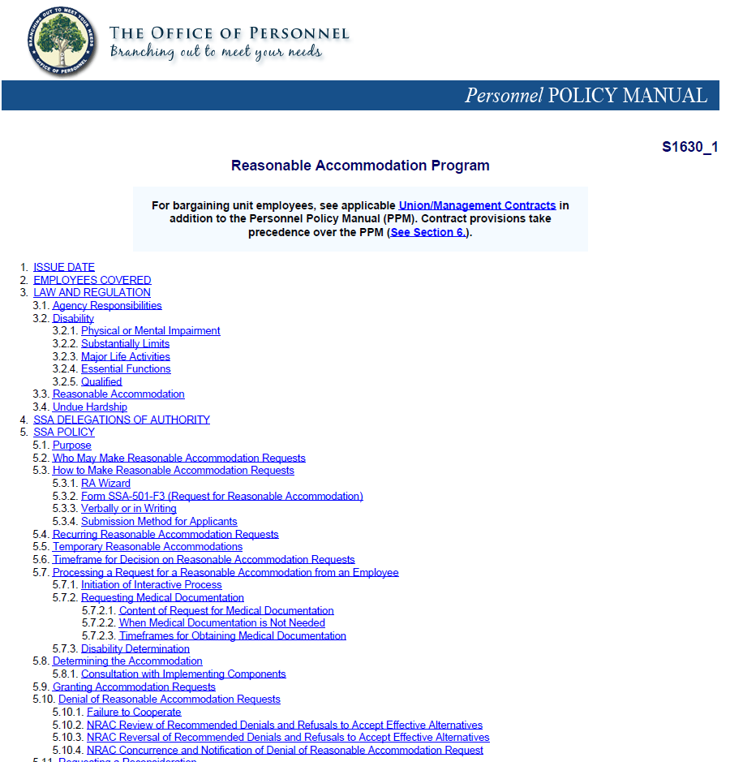
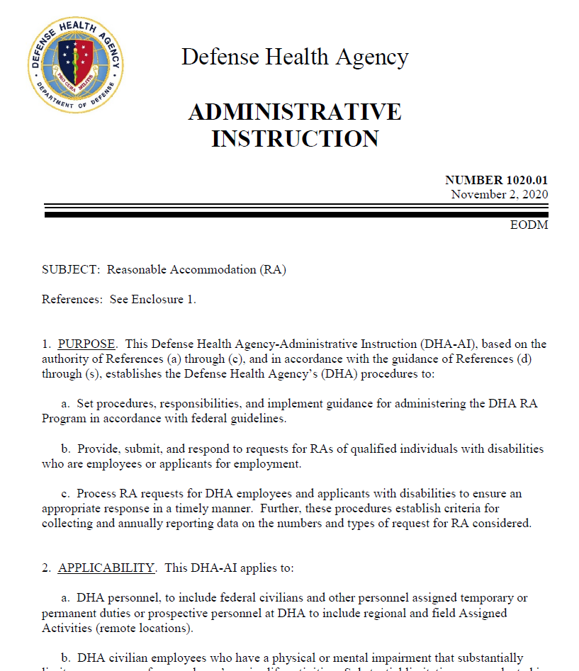
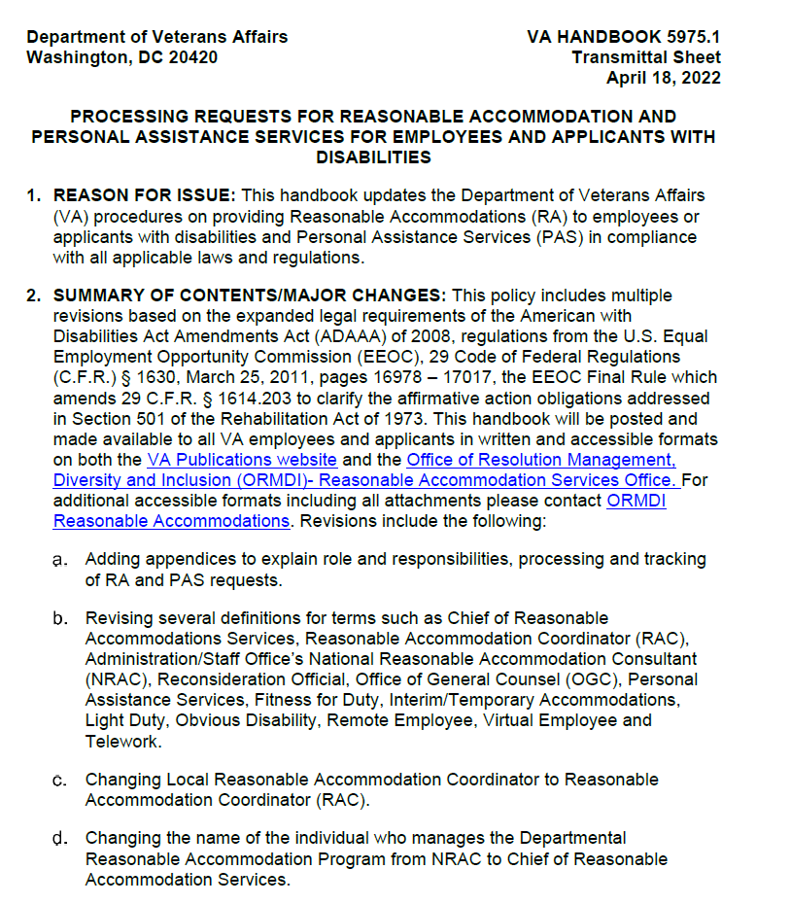
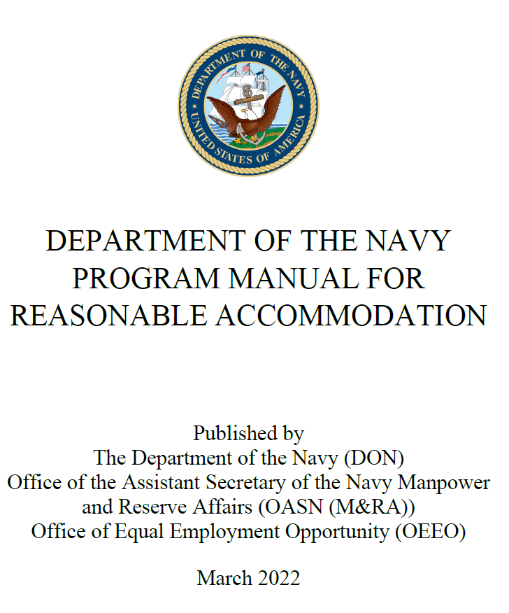
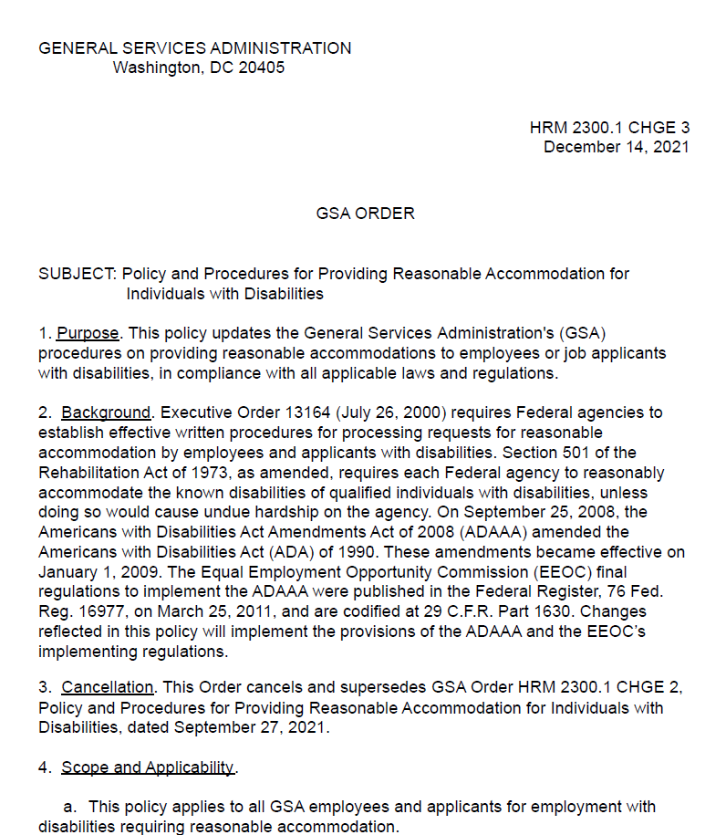
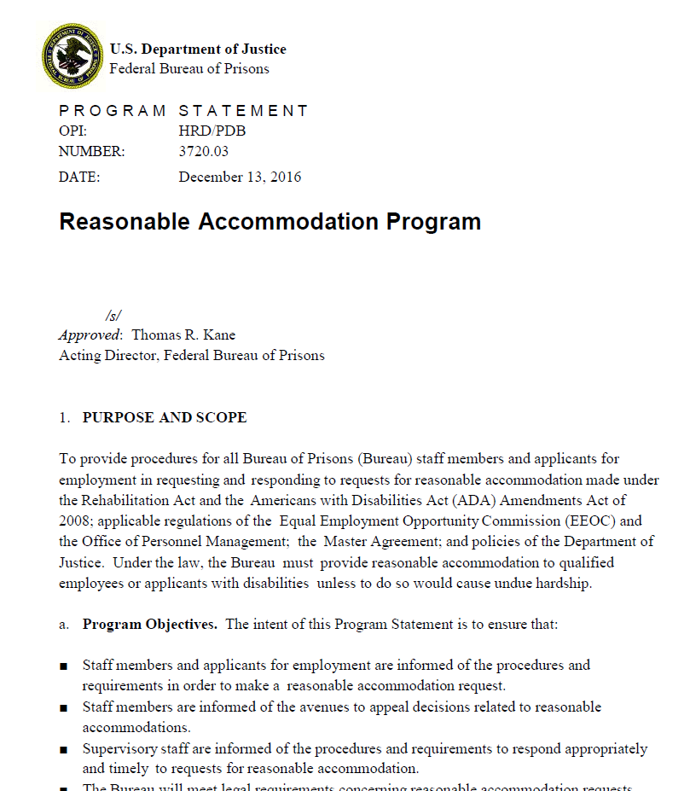
YOU MUST FOLLOW YOUR AGENCY’S PROCEDURES

Slide 23
REASONABLE ACCOMMODATIONS REQUESTS
Do not initially have to be in writing (but they should be for record keeping purposes)
Initiate trigger the Agency’s RA procedures and the interactive process

Slide 24
COMMON RA APPROVAL OBSTACLES
Below are some common obstacles that employees face when requesting a reasonable accommodation:
Provide a diagnosis of a mental or physical impairment from a treating health care provider.
Identify manifestations of the mental or physical impairment
Identify the basic essential functions of the job

Slide 25
COMMON RA APPROVAL OBSTACLES CONTINUED
Identify how the manifestations of the physical or mental impairment limits the ability to perform the essential functions of the job
5. Explain how the manifestations of the physical or mental impairment will be mitigated by a reasonable accommodation
6. Report/document ineffective RA

Slide 26
BRIDGE THE LIMITATION
AND THE RA REQUEST
Mental or Physical Impairment
Diagnosis
Limitations
Reasonable
Accommodation
Request

Slide 27
TELEWORK AS A REASONABLE ACCOMMODATION
An employer does not demonstrate undue hardship when it does not explore reasonable accommodation options and only speculates about the impact of accommodating the employee
Heidi B. v. USPS, EEOC Appeal No. 0120182601 (2019)

Slide 28
TELEWORK AS A REASONABLE ACCOMMODATION
To be entitled to telework, employee must show that working outside home would violate medical restrictions and that the job can be done outside the workplace.
Gemmill v. DoT, EEOC No. 0120072201 (2009)

Slide 29
TELEWORK AS A REASONABLE ACCOMMODATION
Telework can be accomplished for part of the day
Petzer v. DoD, EEOC No. 01A50812 (2006)
Agency offered accommodation to 4 hours per day, 4 days at home, 1 day at the office because an essential function of his position required him to use two databases that were not accessible remotely. Employee refused this accommodation, EEOC found that Agency did not discriminate by requiring he come to work

Slide 30
TELEWORK AS A REASONABLE ACCOMMODATION
Employee not entitled to telework if agency provides effective alternative accommodation.
Dennis v. Dept. of Education, EEOC No. 0120090193 (2010)

Slide 31
TELEWORK AS A REASONABLE ACCOMMODATION
An Agency's ten-month delay in providing telework as accommodation is unlawful when the delay is caused by the Agency's unjustified request for additional medical documentation, and the complainant does not contribute to the Agency’s delay.
Doria R. v. National Science Foundation, EEOC Appeal No. 0120152916 (2017)

Slide 32
TELEWORK AS A REASONABLE ACCOMMODATION
A qualified individual with a disability is entitled to an effective reasonable accommodation, not the accommodation of his choice.
Shad R. v. Dep’t of Veterans Affairs, 120 LRP 25684 , EEOC No. 2019003139 (EEOC OFO 2020)

Slide 33
TELEWORK AS A REASONABLE ACCOMMODATION
Forcing an employee to take leave when another accommodation would permit the employee to continue working is not an effective accommodation. EEOC found that Agency discriminated against employee when it denied him the option of working from home on days where his commute was dangerous because it was below -20 degrees outside. Situational telework was an effective accommodation that had worked for years and was not an undue hardship.
Jody L. v. Dep’t of the Air Force, 118 LRP 3648, EEOC Appeal No. 0120151351 (EEOC OFO 2018)

Slide 34
TELEWORK AS A REASONABLE ACCOMMODATION
The duty to provide a reasonable accommodation may require an agency to modify a workplace policy, such as a leave policy, when necessitated by an individual's disability-related limitations, unless it causes an undue hardship. A nurse requested an accommodation of telework for dizziness and migraines, but the Agency denied it because an essential function of her position required her to work in person. The Agency then reassigned her to a position where full-time telework was permitted.
Tynisha H. v. Department of Veterans Affairs, 124 LRP 15919, EEOC No. 2023001229 (EEOC OFO 2024)

Slide 35
Any Questions?
Website: www.afge.org/wfp
Email: eeo@afge.org
Phone: (202) 639-4006

